Slide 1
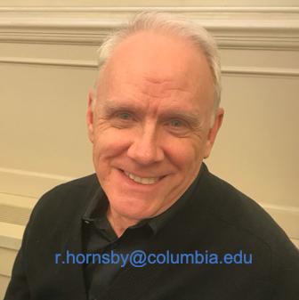
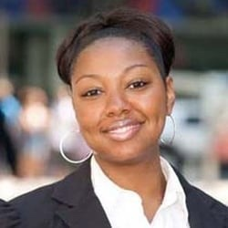
Communications 101
Session 1: Communications Overview
-- Facilitators --
Robert Hornsby Cassandra Nathan

Slide 2
Communications Overview -- Course Basics:
Classes cover general topics relating to theory and practice of communications during 8 weeks.
Each class is organized into three sections:
  A weekly topical presentation,
  A dialogue or interview with an in-house expert, and
  An open question-and-answer session.
Join as many classes as you wish.
Each week we’ll give you an easy research project before the next class, such as collecting three URLS of websites you think are effective.

Slide 3
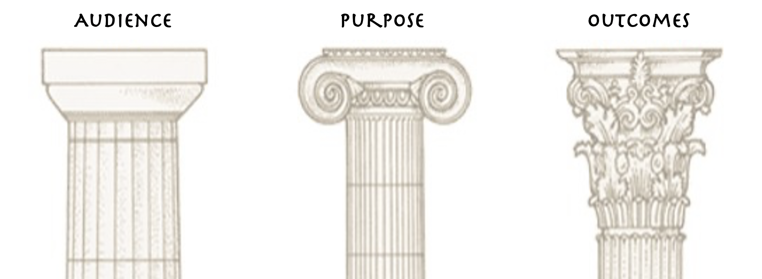
Communications Overview -- Three pillars of Communications:
Audience -- To whom are you communicating?

Slide 4
Communications Overview -- Three pillars of Communications:
Audience -- To whom are you communicating?
Purpose – Why are you communicating? Serving what goal?

Slide 5
Communications Overview -- Three pillars of Communications:
Audience -- To whom are you communicating?
Purpose – Why are you communicating? Serving what goal?
Outcomes – After communicating, what outcomes do you seek?

Slide 6
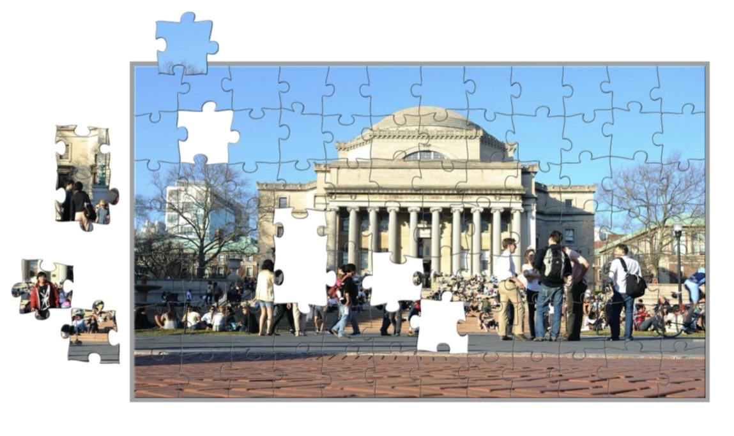
Communications Overview -- Course Topics:
Communications Overview
Media Relations
Community Relations
Social Media
Internal Communications
Creative Resources
Digital Media
Executive Communications
Columba Low Library playable online puzzle

Slide 7
What We Do:
Create content about the University that is meaningful, engaging and purposeful.

Slide 8
What We Do:
Create content about the University that is meaningful, engaging and purposeful.
Deliver and promote that content to stakeholders and audiences both within the University community and externally.

Slide 9
What We Do:
Create content about the University that is meaningful, engaging and purposeful.
Deliver and promote that content to stakeholders and audiences both within the University community and externally.
Facilitate current and future fulfillment of University initiatives.

Slide 10
What We Do:
Create content about the University that is meaningful, engaging and purposeful.
Deliver and promote that content to stakeholders and audiences both within the University community and externally.
Facilitate current and future fulfillment of University initiatives.
We also assist other external entities, such as news outlets (e.g. New York Times, CBS TV, WNYC radio, Huffington Post, etc.) with the production of content about Columbia, often featuring our experts or research.

Slide 11
What We Do: What is “content”?
Name some types of content – written, visual, audio, and multi-media…

Slide 12
What We Do: What is “content”?
Name some types of content – written, visual, audio, and multi-media…
Written content – examples:
  News articles
  Opinion editorials
  Commentary
  Speeches
  Event promotions
  Other?
  Webpages
  Blogs
  Social media posts
  Annual reports
  Webpages
  Blogs
  Social media posts
  Annual reports

Slide 13
What We Do: What is “content”?
Name some types of content – written, visual, audio, and multi-media…
Visual content – examples:
  Photography
  Video
  Graphics
  Other?
Audio content:
  Podcasts
  Voice chat events
Multi-media:
  Zoom events, webinars
● Audio content:
o Podcasts
o Voice chat events
● Multi-media:
o Zoom events, webinars

Slide 14
What We Do: Deliver and promote content
Name some platforms or places where you find our content—both Columbia’s and external…
For this course, “platforms” refer to the medium of transmission – how a story, news or other content is transmitted or delivered to an audience -- that could be online or offline.

Slide 15
What We Do: Deliver and promote content
Name some platforms or places where you find our content—both Columbia’s and external:
  Webpages
  Social media apps (Facebook, Twitter, LinkedIn, Instagram)
  YouTube, Vimeo
  Streaming audio, audio social media apps (voice chat, e.g.: Clubhouse, Wavve, Riffr)
  In print: Newspapers (remember those?) & magazines
  TV broadcast & radio news
  Signage and street banners
  And many others…

Slide 16

What We Do: Deliver and promote content
Notice this – “Digital First” -- the practice of leading communications with online platforms or channels. More about that later…
  Webpages
  Social media – Facebook, Twitter,
  LinkedIn, Instagram
  YouTube, Vimeo
  Podcasts

Slide 17
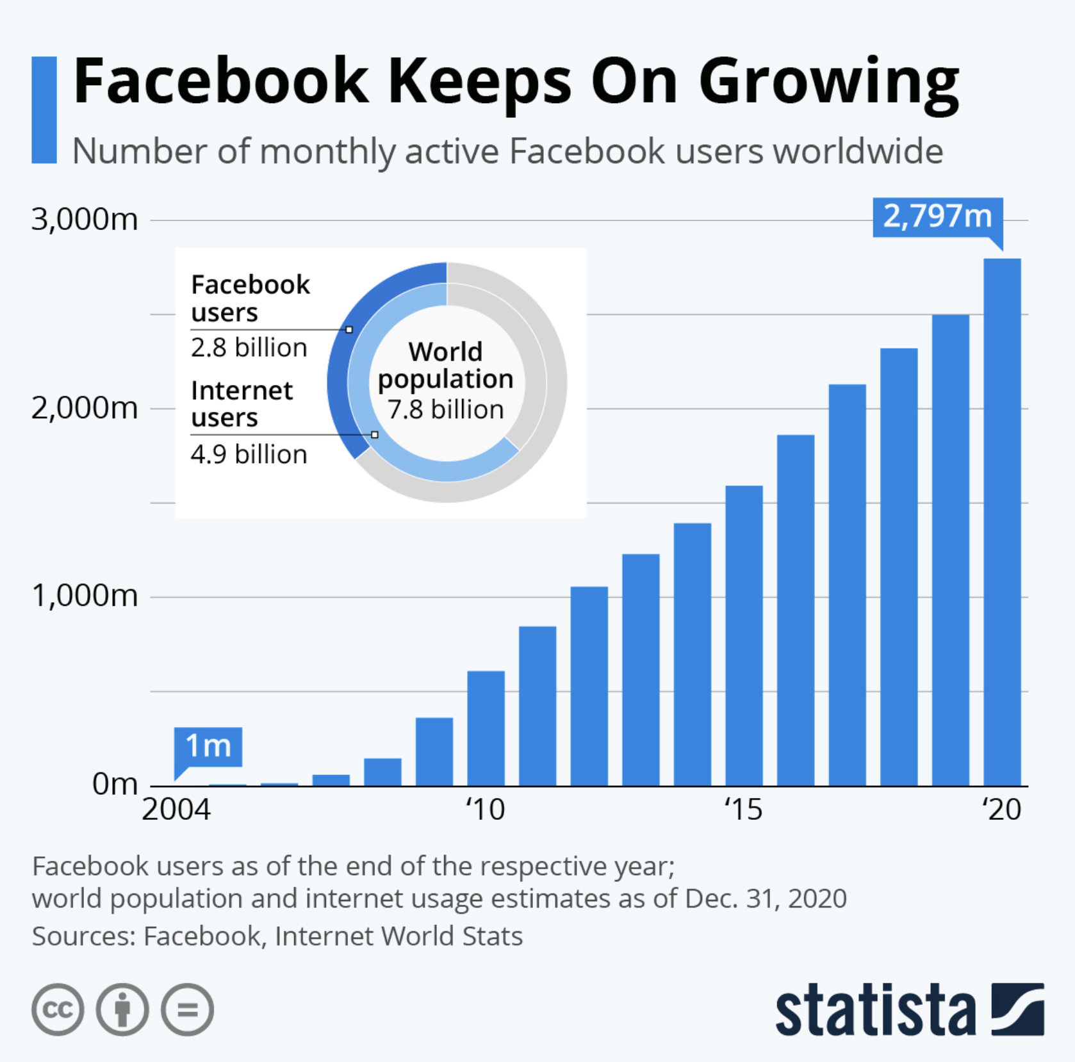
What We Do: Why Digital First? – some statistics:
2020 New York Times subscribers (total print & digital) – 7.5M viewers (6.7M are digital-only)
2020 daily U.S. TV Broadcast news (morning & evening network news shows) -- 8.54M viewers
2021 Twitter users in U.S. – 83.3M users
2020 active Facebook users in North America – 258M users
2020 active Facebook users worldwide – 2.8B users
2020 total world population (est.) – 7.8B people

Slide 18
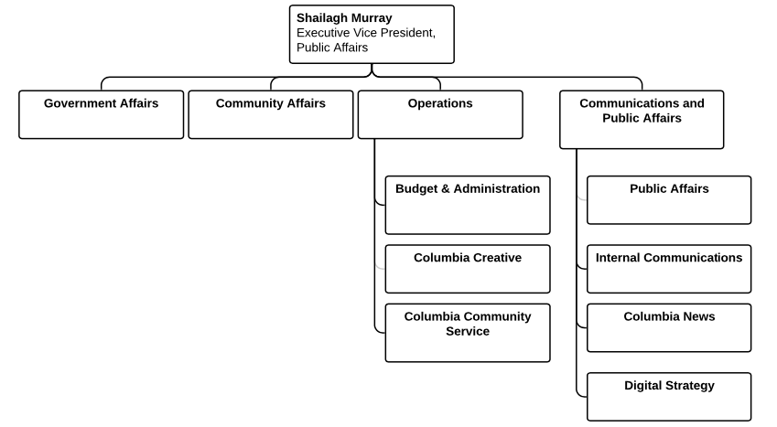
Who does What?
Office Integration
To learn more see:
WHO WE ARE
Office of Communications and Public Affairs

Slide 19
Who does What?
In the course of the next several weeks. We’ll have guests from various units to discuss their roles, responsibilities and day-to-day duties.
We’ll share a dialogue or an interview with each expert.

Slide 20
Who does What?
In the course of the next several weeks. We’ll have guests from various units to discuss their roles, responsibilities and day-to-day duties.
We’ll share a dialogue or an interview with each expert.
Our first guest is Shailagh Murray, Executive Vice President for Public Affairs.
She will be joined in a dialogue by April Maldonado-Brazil, Administrative Coordinator in
the Office of Communications and Public Affairs

Slide 21
Dialogue: “Five Questions”

Slide 22
Question-and-answer period

Slide 23
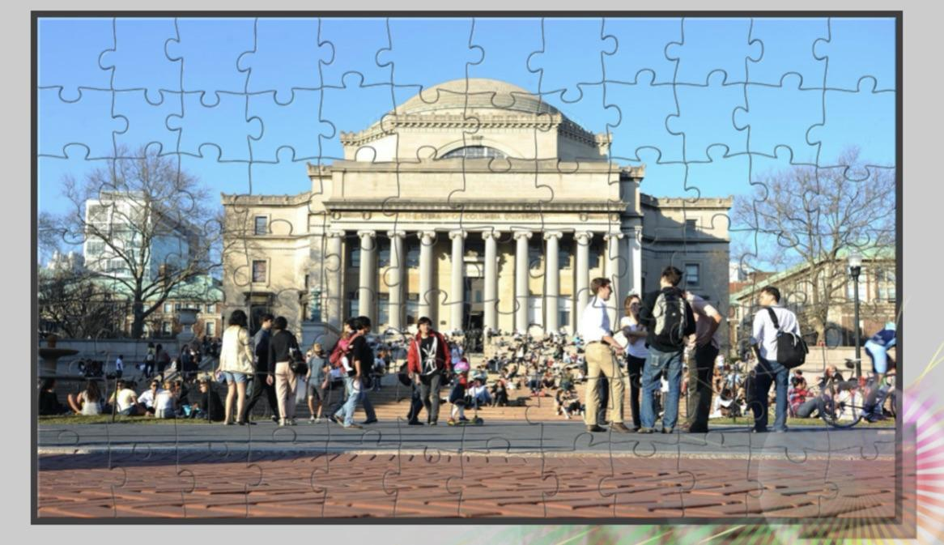
Contact:
Robert Hornsby
r.hornsby@columbia.edu
Cassandra Nathan
cm2891@columbia.edu

